Slide 1
LAMP SOLAR Data calculator
Presented by: Team 2

Slide 2
Meet the Team
Justin Au
Anna Hughes
Tanea Jenkins
Sang Kim
Tyler Newton

Slide 3
Agenda
Meet the Team
Our Stakeholders
Project Goals
Project LAMP Research Team
General Design & Methods Overview
Design
Demo
Questions

Slide 4
Our Stakeholders
Dr. Richard Watson, University of Georgia
Marc Boudreau, University of Georgia
Marc van Iersel , University of Georgia

Slide 5
Project Goals
Quickly calculate the daily LED wattage requirement & cost of growing specific plants in designated zip codes
Utilize historical data from Athens and Cornell with several types of popular crops

Slide 6
Project LAMP Research Team
Review & comment from horticulture subject matter experts on user experience (ease of use, readability, practicality, functionality) of our calculator
Ensure this application is practical for the customers that need it
Reviews from software developers on the calculator’s modularity

Slide 7
General Design & Methods Overview
Utilizing Shiny from R-Studio to make the current R data and files into a modular web application
Integrating the current design into any format while outputting to HTML

Slide 8
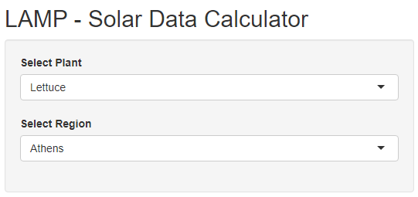
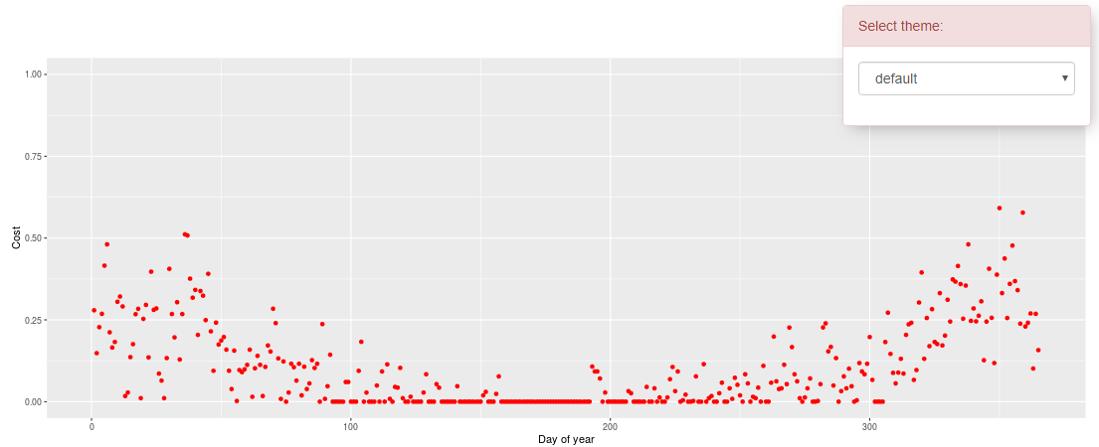
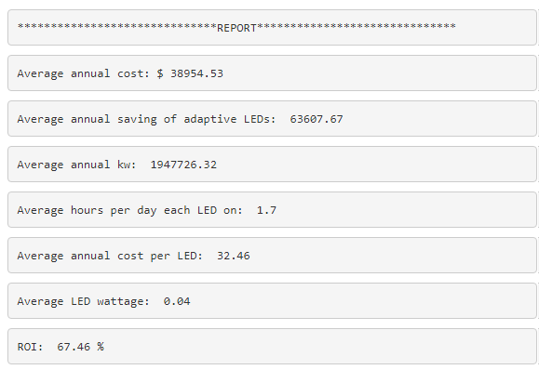
The Design

Slide 9


